Slide 1
Banned Books
By Samantha Mazzeo and Nikole Sullivan

Slide 2
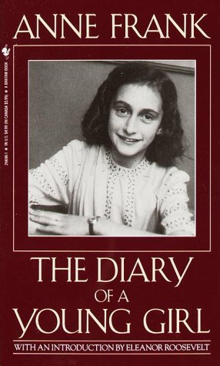

Slide 3
The Diary of Anne Frank, written over a two-year period, tells about Anne’s life while she and her family are in hiding in Holland. They are staying in a secret attic of the office building where Mr. Frank used to work, in order to escape from the Nazis during World War II. During their stay in the annex, they are supported by several people in the office building, who risk their own lives to insure the secrecy of the Jewish hideout and to provide them with basic food and supplies.

Slide 4
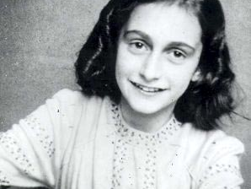

Slide 5
Anne was given a diary for her thirteenth birthday. She loved this diary because it was like an escape from her real life struggles. It was a place where she could write down all of her thoughts and feelings about all the difficult things that were going on in her life at that time.

Slide 6
When her family was finally found in the annex, they were taken away; Anne left her diary and was unable to finish it. Anne’s diary is filled with conflicting emotions, from depression and despair to cheerfulness and delight. Anne constantly tries to see the good side of things and to have hope in spite of the misery and fear she faces on a daily basis.

Slide 7
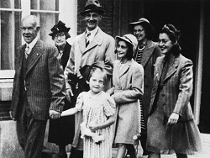
Anne Frank and her family are motivated to stay hidden from the Nazis, so that they won’t get taken away to the concentration camps. Through all the hardships that Anne and her family are faced with, their hope is what kept them strong.

Slide 8
The Diary of Anne Frank was challenged in 1982 in Wise County, Virginia due to protests of several parents who complained the book contains sexually offensive passages. Also in 1983 four members of the Alabama State Textbook Committee called for the rejection of this title because it is a “real downer.” Lastly in1998 the book was removed from the Baker Middle School in Corpus Christi, Texas after two parents had said that the book was pornographic. Although the book was banned there was never a court case. (Lombardi)

Slide 10
Censorship is the act of banning of cutting proportions, usually controls or represses the behavior of others. Richard King once said, “Censorship of ideas or images or words is wrong.” This means that people should have the right to pick what they read or watch. Censorship is a violation of the first amendment, freedom of press and speech. We agree with Richard King because censorship is a negative aspect of our community and we feel that we should be able to express ourselves through our reading.

Slide 11
Works Cited
Chasitymoody. "50 Banned Books: Anne Frank: The Diary of a Young Girl." Parenthetical Views. Web. 01 Oct. 2010. <http://www.parentheticalviews.com/?p=49>.
"The Diary of Anne Frank, PBS Masterpiece Classic: A Review « Jane Austen's World." Jane Austen's World. Web. 01 Oct. 2010. <http://janeaustensworld.wordpress.com/2010/04/09/the-diary-of-anne-frank-pbs-masterpiece-classic-a-review/>.
Lombardi, Esther. "Banned Books." About.com: Need. Know. Accomplish. Web. 30 Sept. 2010. <http://www.about.com/>.
"Wordsworthyreadingpaths / Anne Frank: The Diary of a Young Girl." Wordsworthyreadingpaths / FrontPage. Web. 01 Oct. 2010. <http://wordsworthyreadingpaths.pbworks.com/Anne-Frank:-The-Diary-of-a-Young-Girl>.

